Slide 1
Computer Memory
Chapter:6
Prepared By
Mehedi Hasan Imran
Lecturer, BAUET
Dept. of ICE

Slide 2
The computer memory holds the data and instructions needed to process raw data and produce output. The computer memory is divided into large number of small parts known as cells. Each cell has a unique address which varies from 0 to memory size minus one.
Computer memory is of two types: Volatile (RAM) and Non-volatile (ROM). The secondary memory (hard disk) is referred as storage not memory.
But, if we categorize memory on behalf of space or location, it is of four types:
Register memory
Cache memory
Primary memory
Secondary memory

Slide 3
Register Memory
Register memory is the smallest and fastest memory in a computer. It is not a part of the main memory and is located in the CPU in the form of registers, which are the smallest data holding elements. A register temporarily holds frequently used data, instructions, and memory address that are to be used by CPU. They hold instructions that are currently processed by the CPU. All data is required to pass through registers before it can be processed. So, they are used by CPU to process the data entered by the users. Registers hold a small amount of data around 32 bits to 64 bits.
Types and Functions of Computer Registers:
Data Register: It is a 16-bit register, which is used to store operands (variables) to be operated by the processor. It temporarily stores data, which is being transmitted to or received from a peripheral device.
Program Counter (PC): It holds the address of the memory location of the next instruction, which is to be fetched after the current instruction is completed. So, it is used to maintain the path of execution of the different programs and thus executes the programs one by one, when the previous instruction gets completed.
Instructor Register: It is a 16-bit register. It stores the instruction which is fetched from the main memory. So, it is used to hold instruction codes, which are to be executed. The Control Unit takes instruction from Instructor Register, then decodes and executes it.

Slide 4
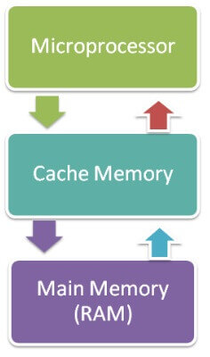
Accumulator Register: It is a 16-bit register, which is used to store the results produced by the system. For example, the results generated by CPU after the processing are stored in the AC register.
Address Register: It is a 12-bit register that stores the address of a memory location where instructions or data is stored in the memory.
I/O Address Register: Its job is to specify the address of a particular I/O device.
I/O Buffer Register: Its job is to exchange the data between an I/O module and the CPU.
Cache Memory
Cache memory is a high-speed memory, which is small in size but faster than the main memory (RAM). The CPU can access it more quickly than the primary memory. So, it is used to synchronize with high-speed CPU and to improve its performance.
Cache memory can only be accessed by CPU. It can be a reserved part of the main memory or a storage device outside the CPU. It holds the data and programs which are frequently used by the CPU. So, it makes sure that the data is instantly available for CPU whenever the CPU needs this data. In other words, if the CPU finds the required data or instructions in the cache memory, it doesn't need to access the primary memory (RAM). Thus, by acting as a buffer between RAM and CPU, it speeds up the system performance.f

Slide 5
How does cache memory work with CPU?
When CPU needs the data, first of all, it looks inside the L1 cache. If it does not find anything in L1, it looks inside the L2 cache. If again, it does not find the data in L2 cache, it looks into the L3 cache. If data is found in the cache memory, then it is known as a cache hit. On the contrary, if data is not found inside the cache, it is called a cache miss.
If data is not available in any of the cache memories, it looks inside the Random Access Memory (RAM). If RAM also does not have the data, then it will get that data from the Hard Disk Drive.
So, when a computer is started for the first time, or an application is opened for the first time, data is not available in cache memory or in RAM. In this case, the CPU gets the data directly from the hard disk drive. Thereafter, when you start your computer or open an application, CPU can get that data from cache memory or RAM.

Slide 6
Primary Memory
Primary Memory is of two types: RAM and ROM.
RAM (Volatile Memory)
It is a volatile memory. It means it does not store data or instructions permanently. When you switch on the computer the data and instructions from the hard disk are stored in RAM.
CPU utilizes this data to perform the required tasks. As soon as you shut down the computer the RAM loses all the data.
ROM (Non-volatile Memory)
It is a non-volatile memory. It means it does not lose its data or programs that are written on it at the time of manufacture. So it is a permanent memory that contains all important data and instructions needed to perform important tasks like the boot process.

Slide 7
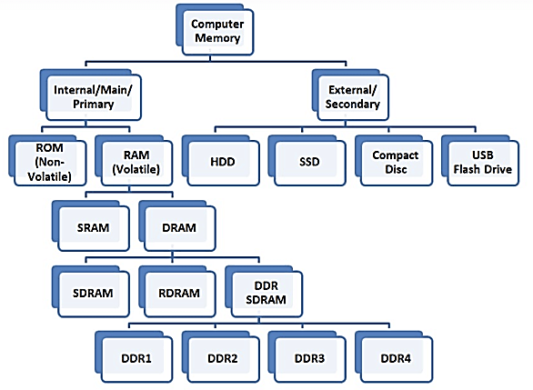

Slide 8
Two main types of RAM are:
Static RAM
Dynamic RAM
SRAM | DRAM
SRAM has lower access time, so it is faster compared to DRAM. | DRAM has higher access time, so it is slower than SRAM.
SRAM is costlier than DRAM. | DRAM costs less compared to SRAM.
SRAM requires a constant power supply, which means this type of memory which consumes more power. | DRAM offers reduced power consumption because the information is stored in the capacitor.
It is a complex internal circuitry, and it offers less storage capacity is available compared to the same physical size of a DRAM memory chip. | It is the small internal circuitry in the one-bit memory cell of DRAM. The large storage capacity is available.
SRAM has a low packaging density. | DRAM has a high packaging density.

Slide 9
Read Only Memory(ROM)
Various types of ROMs and their characteristics is given below.
MROM (Masked ROM)
The very first ROMs were hard-wired devices that contained a pre-programmed set of data or instructions. These kind of ROMs are known as masked ROMs, which are inexpensive.
PROM (Programmable Read Only Memory)
PROM is read-only memory that can be modified only once by a user. The user buys a blank PROM and enters the desired contents using a PROM program. Inside the PROM chip, there are small fuses which are burnt open during programming. It can be programmed only once and is not erasable.
EPROM (Erasable and Programmable Read Only Memory)
EPROM can be erased by exposing it to ultra-violet light for a duration of up to 40 minutes. Usually, an EPROM eraser achieves this function. During programming, an electrical charge is trapped in an insulated gate region. The charge is retained for more than 10 years because the charge has no leakage path. For erasing this charge, ultra-violet light is passed through a quartz crystal window (lid). This exposure to ultra-violet light dissipates the charge. During normal use, the quartz lid is sealed with a sticker.

Slide 10
EEPROM (Electrically Erasable and Programmable Read Only Memory)
EEPROM is programmed and erased electrically. It can be erased and reprogrammed about ten thousand times. Both erasing and programming take about 4 to 10 ms (millisecond). In EEPROM, any location can be selectively erased and programmed. EEPROMs can be erased one byte at a time, rather than erasing the entire chip. Hence, the process of reprogramming is flexible but slow.
Advantages of ROM
The advantages of ROM are as follows −
Non-volatile in nature
Cannot be accidentally changed
Cheaper than RAMs
Easy to test
More reliable than RAMs
Static and do not require refreshing
Contents are always known and can be verified

Slide 11
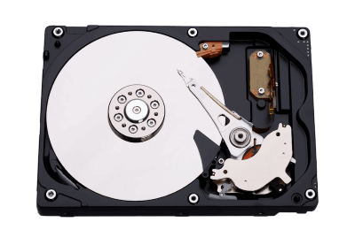
Secondary Memory
The secondary storage devices which are built into the computer or connected to the computer are known as a secondary memory of the computer. It is also known as external memory or auxiliary storage.
Some of the secondary memory or storage devices are described below:
1) Hard Disk:
It is a rigid magnetic disc that is used to store data. It permanently stores data and is located within a drive unit. The hard disk is also known as a hard drive.

Slide 12
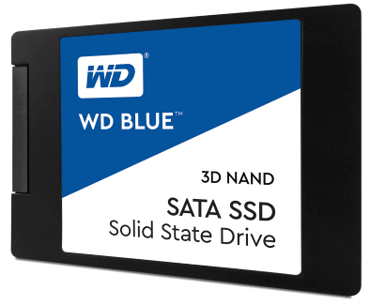
2) Solid-state Drive: SSD (Solid State Drive) is also a non-volatile storage medium that is used to hold and
access data. Unlike a hard drive, it does not have moving components, so it offers many advantages over SSD,
such as faster access time, noiseless operation, less power consumption, and more.
3) Pen drive: Pen drive is a compact secondary storage device. It is also known as a USB flash drive, thumb
drive or a jump drive. It connects to a computer via a USB port. It is commonly used to store and transfer data
between computers.

Slide 13
4) SD Card: SD Card stands for Secure Digital Card. It is most often used in portable and mobile devices such
as smartphones and digital cameras. You can remove it from your device and see the things stored in it using a
computer with a card reader.
5) Compact Disk (CD): Compact Disk is a portable secondary storage device in the shape of a round medium
disk. It is made of polycarbonate plastic. The concept of CD was co-developed by Philips and Sony in 1982.
The first CD was created on 17 August 1982 at the workshop of Philips in Germany.
6) DVD: DVD is short for digital versatile disc or digital video disc. It is a type of optical media used for
storing optical data. Although it has the same size as a CD, its storage capacity is much more than a CD. So,
it is widely used for storing and viewing movies and to distribute software programs as they are too large to
fit on a CD. DVD was co-developed by Sony, Panasonic, Philips, and Toshiba in 1995.

Slide 14
Memory Units
Memory units are used to measure and represent data. Some of the commonly used memory units are:
1) Bit: The computer memory units start from bit. A bit is the smallest memory unit to measure data stored in main memory and storage devices. A bit can have only one binary value out of 0 and 1.
2) Byte: It is the fundamental unit to measure data. It contains 8 bits or is equal to 8 bits. Thus a byte can represent 2*8 or 256 values.
3) Kilobyte: A kilobyte contains 1024 bytes.
4) Megabyte: A megabyte contains 1024 kilobytes.
5) Gigabyte: A gigabyte contains 1024 megabyte.
6) Terabyte: A terabyte contains 1024 gigabytes.

Slide 15
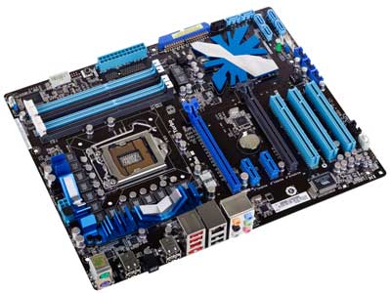
Flash Memory: Flash memory is a non-volatile memory chip used for storage and for transferring data
between a personal computer (PC) and digital devices. It has the ability to be electronically reprogrammed
and erased. It is often found in USB flash drives, MP3 players, digital cameras and solid-state drives.
Cache Memory: Cache memory is a small-sized type of volatile computer memory that provides high-speed
Data access to a processor and stores frequently used computer programs, applications and data.
Motherboard
The motherboard serves as a single platform to connect all of the parts of a computer together. It connects the CPU, memory, hard drives, optical drives, video card, sound card, and other ports and expansion cards directly or via cables. It can be considered as the backbone of a computer.

Slide 16
Features of Motherboard
A motherboard comes with following features −
Motherboard varies greatly in supporting various types of components.
Motherboard supports a single type of CPU and few types of memories.
Video cards, hard disks, sound cards have to be compatible with the motherboard to function properly.
Motherboards, cases, and power supplies must be compatible to work properly together.
Popular Manufacturers
Following are the popular manufacturers of the motherboard.
Intel, ASUS, Aopen, ABIT, Biostar, Gigabyte, MSI

